Slide 1

why web components?
@mikegeyser
31 January 2020

Slide 3


Jozi.js February: dream BIG
Thursday, February 20th
18:30-20:30 in Killarney
meetup.com/jozi-js/events/267774036/
Soweto.js February: phupha KAKHULU
Saturday, February 29th
11:00-13:00 in Orlando
meetup.com/jozi-js/events/268080620/

Slide 4
Mike!
Gery!

Slide 5
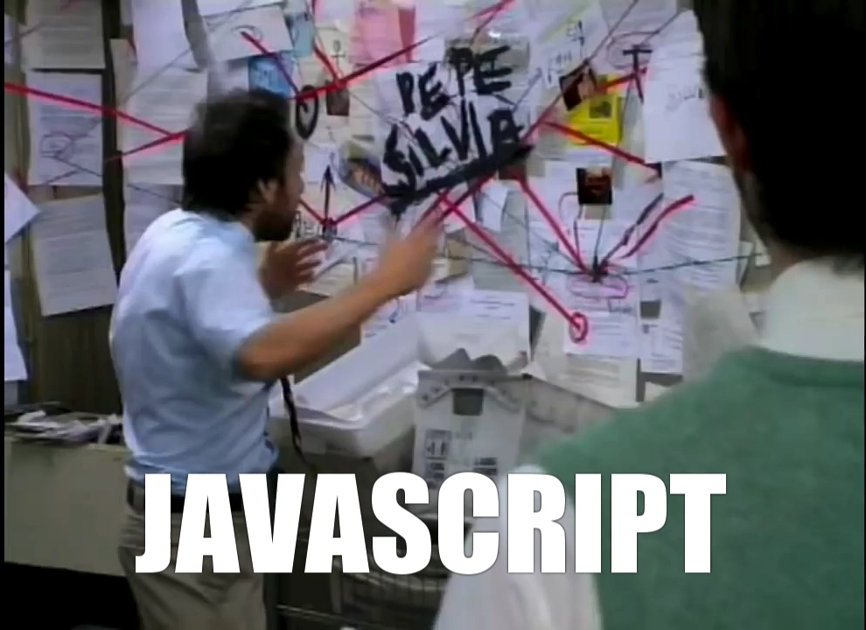

Slide 6




ES5
ES6
ES2015
ES2016
ES2017
ES2018

Slide 7
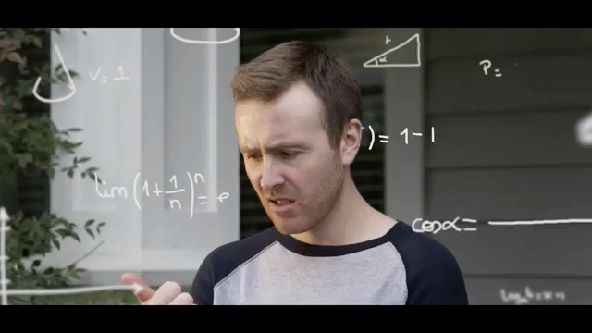

Slide 8
ES2015+
Web Components
+
🔥

Slide 9
web components
Web Standards
-> Customiseable
-> Reuseable
-> Encapsulated
Built-in APIs
-> Custom Elements API
-> Shadow DOM

Slide 10
what we’ll use
es-dev-server
-> Bare module imports
lit-html
-> Template rendering
LitElement
-> Change detection

Slide 11
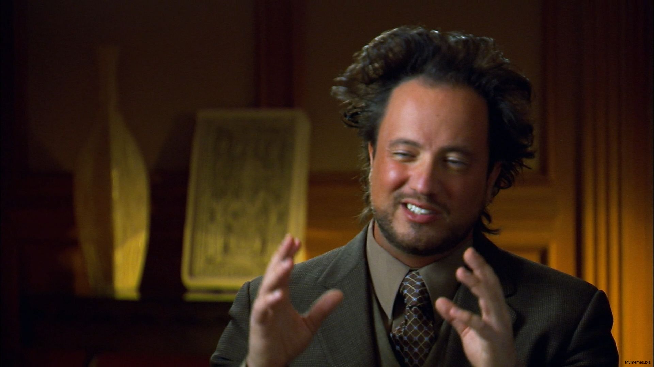
JAVASCRIPT

Slide 12
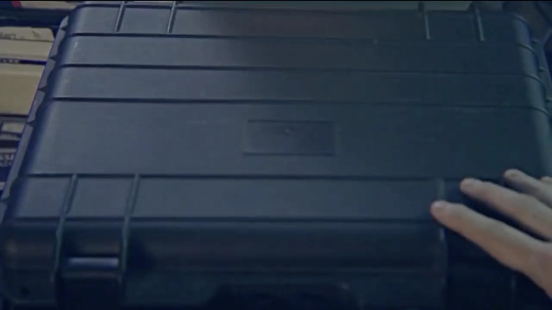
DEMO TIME

Slide 13
in summary
It can (and should) be easier.
It doesn’t *have* to be this (it just works for me).
Keep it simple. Use the platform.

Slide 14
questions?
@JoziJs
meetup.com/jozi-js
@mikegeyser
mikerambl.es/videos

